Slide 1
Top 100 Music Dashboard
Boris Smirnov
Jose Davila
Leah Lindy
Nupur Gupta

Slide 2
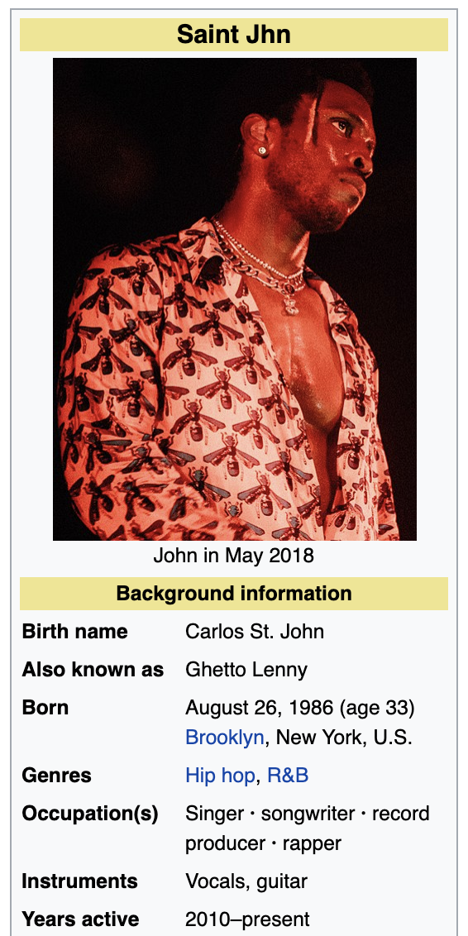
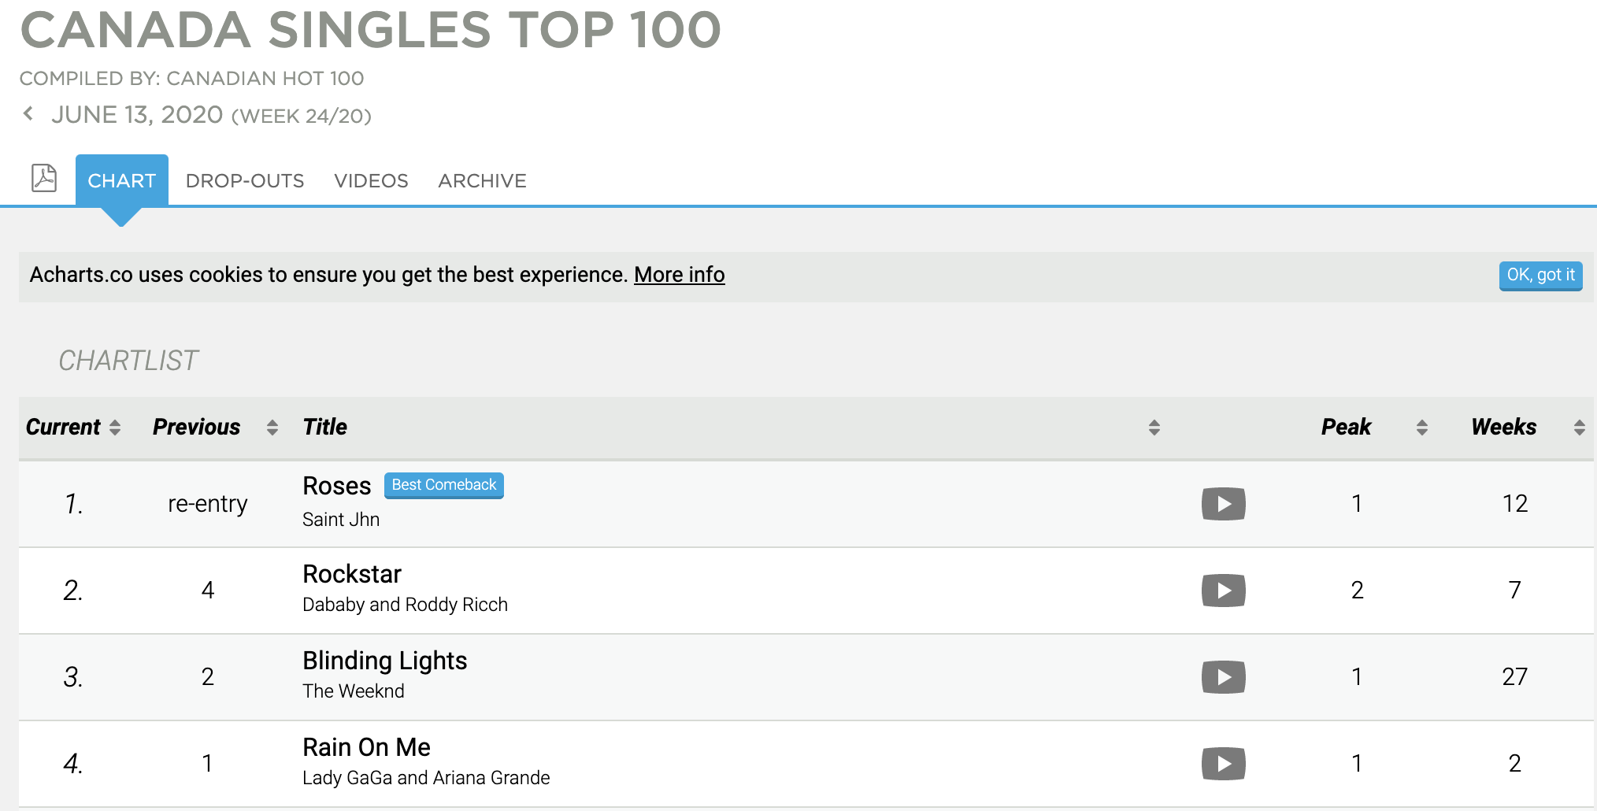
Data Extraction
Notes:
We collected information from all songs, from beginning of the chart until today. Then we gather wiki information for each artist to get genre and artist information. This makes the data more meaningful for the user.

Slide 3
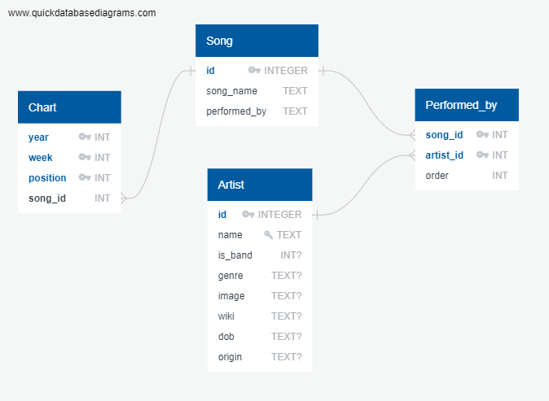
Entity Relationship Diagram
Organize extracted data within a SQL database
Common requests to the database are saved as views
681 weeks starting from March 31, 2007
2055 Artists
1690 scraped
365 unscraped (17.76%)
6332 Songs

Slide 4
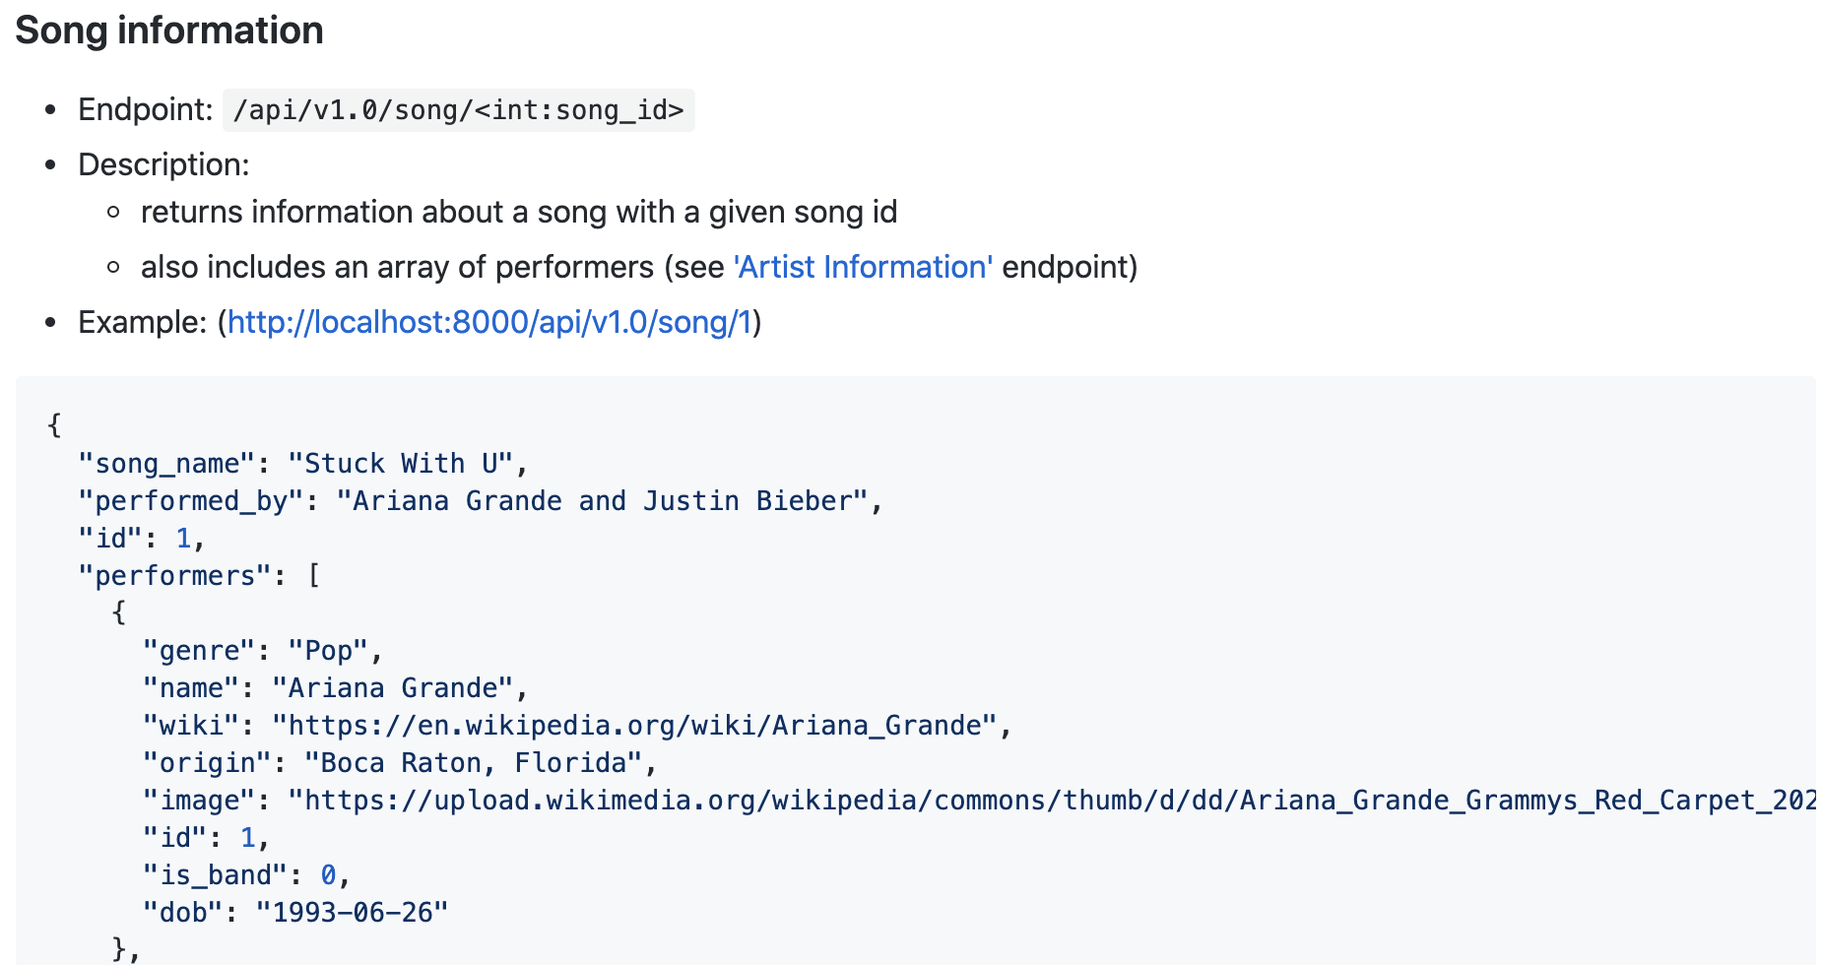
Server
Multiple API endpoints created for ease of use
Depending on information required for visualizations

Slide 5
Dashboard
See our work in action

Slide 6
Project Requirements
Python Flask-powered API
HTML/CSS
JavaScript
SQLite
Web scraping + Plotly
Chroma.js - color manipulation library (first chart)
Way more than 100 records
Dropdowns on charts to filter/choose dataset
5 charts on the Dashboard
Presentation

